Slide 1
Safety Equipment

Slide 2
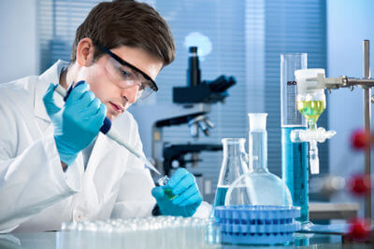
In this Smart Lesson you will:
Name different types of safety equipment.
Clarify when you need to use them in the science lab.

Slide 3
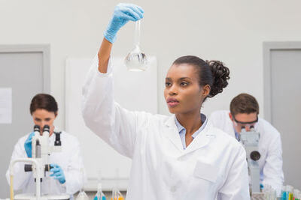
Why is it important to be safe in a lab?
A laboratory may look like an ordinary place, but it is filled with many hazards.

Slide 4

There is a lot of glassware in the lab.
Since we commonly use equipment such as test tubes and beakers in the lab we need to be careful in case we have any breakages.
We don't want to get any cuts on ourselves.

Slide 5
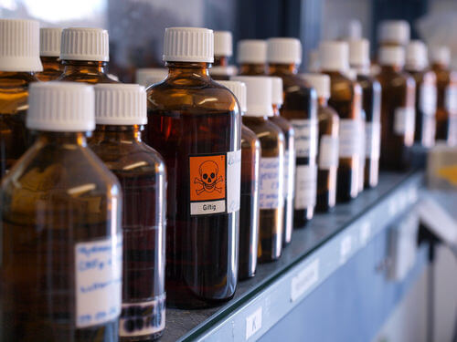
In the lab there are a lot of chemicals which we use for experiments.
Some of these can be toxic and can cause us harm if any accidentally gets on our skin or clothes or is ingested somehow.
Sometime the chemicals can be a powder or even a gas.

Slide 6
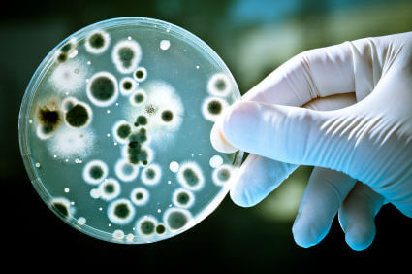
Some labs deal with biological material such as animals, microbes or blood.
If we are not careful, these can make us or other people ill.

Slide 7
As some experiments require heating with Bunsen burners or the usage of chemicals, fire and burns can be a danger.
This can obviously lead to serious burns and smoke that can damage property and more importantly harm us.

Slide 8
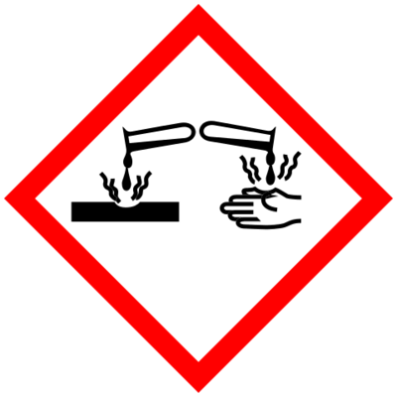
Now that we've established the hazards in a lab.
Let's go over the safety equipment we use to protect ourselves.

Slide 9
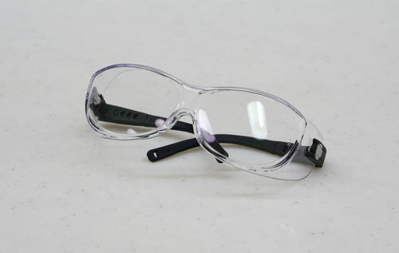
Safety glasses are an important piece of equipment.
Safety glasses protect your eyes from dangerous materials.
These include things such as chemicals and shards of glass and metal.

Slide 10
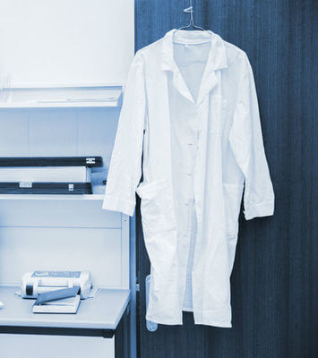
You should always wear a lab coat when in the lab.
Lab coats protect your skin and clothes from dangerous materials.
These include things such as chemicals, biological material and shards of glass.

Slide 11
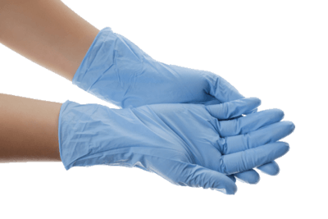
As we use our hands in the lab, we should protect them.
Rubber gloves are used to protect your hands from dangerous chemicals and possibly infectious material.
We often wear gloves when dealing with chemicals and other things such as blood or sick people or animals.

Slide 12
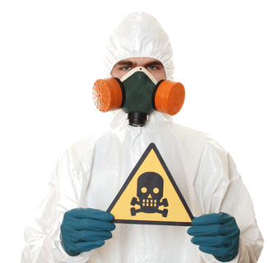
So how do we protect our insides?
Respirators are used to protect your lungs from dangerous dusts, fumes, gases and pathogens.
These can be hard to see, but if it can be airborne then it is best to wear a respirator.

